Slide 1

Advance government priorities with the mission-critical cloud
Engage your citizens for greater community connection and participation
Empower your employees to improve efficiency and quality of in-person citizen services
Transform Government services to unlock insight on operations and performance
Optimize government operations to rapidly deliver new agency and citizen services
Notes:
1 min - Puneet-
Meet your mission and serve citizens better
Microsoft empowers Digital Government Transformation with a unique choice of public, private and hybrid, hyper-scale cloud services with a commitment to openness and providing a Cloud that Governments can trust.
Why should government leaders care about artificial intelligence (AI)? The answer is simple: because AI can help the public sector deliver better services to citizens at lower cost. In fact, the rise of AI holds great promise for government at all levels.
AI helps us find patterns in existing data, then recognize those patterns when they reappear again
Every government leader needs to understand how AI can benefit their organization by saving money, creating a better citizen experience, or in some other way.
We [at Microsoft] have an opportunity to improve support for and protection of U.S. service members, safeguard our citizens, defend our allies and partners, and improve the affordability and speed of our operations…
Microsoft technology throughout the American military, helping power its front office, field operations, bases, ships, aircraft and training facilities.
Engage and service citizens more effectively:
Enable personal assistants to guide citizens through a service request.
Alert travelers of real-time traffic problems, create customized journeys for citizens.
Employ intelligent search agents to deliver personalized on-demand digital services and improve transparency.
Keep citizens informed with automated tools that route and monitor service requests.
Empower government employees to deliver efficient service:
Create self-service bots to give employees instant access to public information and services.
Improve public assets management through predictive models.
Use advanced analytics to expedite the workflow process and identify the next best action.
Match pool of skillsets versus open positions in social services environments.
Optimize government operations:
Employ advanced analytics and predictive models to identify and meet the demand of specific social services.
Use predictive analytics for forecasting demand of public transportation units.
Identify compliance issues in claims.
Transform government services:
Develop criminal activity forecasting for better public safety asset distribution.
Integrate and correlate public information for better analysis.
Listen, answer, and route citizens in social media with digital assistants.
The Microsoft focus on delivering a trusted cloud and innovating productivity and mobility solutions supported by a vast network of device, software and services partners, all empower workers in every government organization to achieve more for the institutions, businesses and citizens they serve. This bold mission is supported by our ambitions to create more personal computing, to reinvent productivity and business processes, and to build the intelligent cloud platform. These three ambitions will empower digital government transformation to better engage with citizens, empower their employees, optimize their operations and reinvent services and government business models.

Slide 2








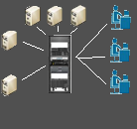








Unique AI government opportunities
Improve Citizen Experience
Public Safety
Social network analysis
Logistics optimization, lowering maintenance cost in pubic safety
Web app optimization
Fraud detection
IT infrastructure optimization
Analytics Data Consolidation
Weather forecasting
Healthcare outcomes
Scientific research
Equipment monitoring
Smart Sensor monitoring
Notes:
5 min Puneet - The Microsoft Difference in AI

Slide 3






Microsoft’s Approach to AI
Pretrained models
To simplify solution development
…
Vision
Speech
Language
Web search
Decision
Simple Customization
To simplify model development
…
Custom Vision
Custom Speech
Custom Language
Custom search
Visual Studio Code
Build from Scratch
To build advanced deep learning solutions
PyTorch
TensorFlow
Scikit-Learn
ONNX
PyTorch
Azure Machine Learning
Azure Databricks
Machine Learning VMs
Powerful infrastructure
To accelerate deep learning
Azure Machine Learning
CPU
GPU
FPGA
CPU
From the Intelligent Cloud to the Intelligent Edge
Notes:
The Microsoft Difference in AI If your organization needs to create custom models, Microsoft has tools such as Azure Machine Learning Studio to help you do this. These tools are meant to be used by both professional data scientists and less-skilled people. But Microsoft also provides a broad set of pre-built models. Called Microsoft Cognitive Services, these models address many common scenarios, including image recognition, interpreting human speech, and lots more. Building your own model requires time, money, and skilled data scientists. Using Microsoft’s pre-built models whenever possible makes much more sense. The ability to do this, combined with a range of tools to create new models when you need to, is why Microsoft is the right choice for your AI projects.
Our deployment options span cloud, on-premises and even the edge
9:10
9:10
I just want to spend a couple of minutes on MSFT's approach to AI and cognitive services. I am going to start from the bottom. The reason I am going to start from the bottom is ..because most of our SI partners have people with software or engineering background. If you need to build custom solutions, we have got everything from
Customer machine learning or AI model that you want. You can deploy AI all the way down to the chip set, but MSFT wants to help people like me look like rock stars - because you can take pre-trained sophisticated models - whether it is a speech model or vision model or a language understanding model - which we have spend millions of dollars and thousands of engineers building those model, you can access those model with simple API call - your developers can make a simple REST API call and send some information and get back a JSON payload and get a result. This way you are just accessing the AI with a simple API call. Frankly this is the only way AI is going to scale.
There are more people in the world doing architecture, engineering and programming than people who are able do the Data science level of it, right? Data scientist have the background and skill sets - mathematically to understand what is going on there - but most of the us - don’t . You have to if you have to do it at the lower level.
In order to scale in an organizations - these sorts of cognitive services where you can do simple API calls or take it to the next level - do it a little bit of customization - Chris will show you that - instead of saying that you want to identify something as a vehicle - let me differentiate in a tank, a jeep or a Hum V - you can do some very simple customization and modeling and labeling - and will be able to tell that.
----------------
Trusted AI services
Our trusted AI services accelerate the development of AI solutions—from pre-built APIs, such as Cognitive Services and Conversational AI with bot tools, to platforms for building custom models such as Azure Machine Learning Studio.
Pre-built services (Cognitive Services) enable developers to make their apps more intelligent and engaging by infusing them with cognitive capabilities. These services are high-quality RESTful intelligent APIs for Vision, Speech, Language, Knowledge, and Search. With just a few lines of code, developers that are new to AI can infuse their applications with cognitive capabilities to communicate with users in natural language, identify relevant content in images, and recognize users by voice.
Custom models built on Azure Machine Learning Studio enable organizations to make better decisions, at any scale, when it matters. Azure Machine Learning Studio is a fully managed cloud service for data scientists and developers that helps easily prepare data, build and train custom models. Spanning from the edge to the cloud, users can access the service from any device—going from idea to deployment in a matter of clicks. We also support further extensibility with producing models with other platforms, such as Azure Databricks, for large scale capable of processing terabytes, even petabytes of data.
Data Science VMs save developers time by providing a ready-to-use image that can be provisioned on Azure. The image comes preinstalled, configured, and tested with several popular tools that are commonly used for data analytics, machine learning, and AI training. DSVMs offer on-demand elastic capacity for large-scale projects and a pay-as-you-go structure.
Knowledge Mining helps manage the chaos of data and tackles the challenges that distract developers from finding the information they need. Powered by Azure Search with built-in Cognitive Services, Knowledge Mining is an AI-first approach to content understanding. It pulls data from a variety of Azure data sources and applies a set of composable cognitive skills that extract knowledge. This knowledge is then organized and stored in a search index enabling new experiences when exploring data.

Slide 4






Microsoft Cognitive Services Give your apps a human side
Vision
From faces to feelings, allow your apps to understand images and video
Speech
Hear and speak to your users by filtering noise, identifying speakers, and understanding intent
Language
Process text and learn how to recognize what users want
Knowledge
Map complex information and data in order to solve specific tasks
Search
Access billions of web pages, images, videos, and news with the power of Bing
Labs
An early look at emerging Cognitive Services technologies: discover, try, and give feedback on new technologies before general availability
Notes:
Chris – 2 min

Slide 5





Cognitive Services capabilities Infuse your apps, websites, and bots with human-like intelligence
Vision
Speech
Language
Knowledge
Search
Object, scene, and activity detection
Face recognition and identification
Celebrity and landmark recognition
Emotion recognition
Text and handwriting recognition (OCR)
Video metadata, audio, and keyframe extraction and analysis
Explicit or offensive content moderation
Custom image recognition
Speech transcription (Speech-to-text)
Speech Synthesis (Text-to-speech)
Real-time speech translation
Speaker identification and verification
Custom Speech models for transcription and translation
Custom voice
Language detection
Text sentiment analysis
Key phrase extraction
Entity recognition
Spell checking
Explicit or offensive text content moderation, PII detection
Text translation
Customizable text translation
Contextual language understanding
Q&A extraction from unstructured text
Knowledge base creation from collections of Q&As
Semantic matching for knowledge bases
Customizable content personalization learning
Ad-free web, news, image, and video search results
Trends for video, news
Image identification, classification and knowledge extraction
Identification of similar images and products
Named entity recognition and classification
Knowledge acquisition for named entities
Search query autosuggest
Ad-free custom search engine creation
Notes:
Vision: Image-processing algorithms to smartly identify, caption and moderate your pictures
Computer vision: Distill actionable information from images
Content Moderator: Automatically moderate potentially offensive images, text and videos
Customer Vision Service: Train a web service to recognize specific content in images
Face: Identify human faces and emotions in images
Video indexer: Easily extract insights from your videos to enrich your applications
Speech: Convert spoken audio into text, use voice for verification, or add speaker recognition to your app
Bing Speech: Convert speech to text and text to speech
Speaker Recognition: Use speech to identify and authenticate individual speakers
Custom Speech Service: Overcome speech recognition barriers like speaking style, background noise, and vocabulary
Translator Speech: Easily conduct real-time speech translation on your app
Language: Enable your apps to process natural language with pre-built scripts, evaluate sentiment and learn how to recognize what users want
Bing Spell Check: Add spell checking functionality to your app
Language Understanding (LUIS): Add language understanding intelligence to your apps with minimal effort
Linguistic Analysis: Easily parse complex text with language analysis
Text Analytics: Easily evaluate sentiment, language, and key phrases to understand what users want
Translator Text: Easily conduct machine translation for 60+ languages
Knowledge: Map complex information and data in order to solve tasks such as intelligent recommendations and semantic search
Knowledge Exploration Service: Enable interactive search experiences over structured data via natural language inputs
Entity Linking Service: Power your app's data links with named entity recognition and disambiguation
Academic Knowledge: Tap into the wealth of academic content in the Microsoft Academic Graph using the Academic Knowledge API
QnA Maker: Distill information into an easy-to-navigate FAQ for bot services
Customer Decision Service: Create custom experiences with adaptive, contextual decision-making
Search: Add Bing Search APIs to your apps and harness the ability to comb billions of webpages, images, videos, and news with a single API call
Bing Autosuggest: Give your app intelligent autosuggest options for searches
Bing News Search: Search for news and get comprehensive results
Bing Web Search: Get enhanced search details from billions of web documents
Bing Entity Search: Enrich your experiences by identifying and augmenting entity information from the web
Bing Image Search: Search for images and get comprehensive results
Bing Video Search: Search for videos and get comprehensive results
Bing Custom Search: Create tailored site search or vertical search experiences for topics you care about
Labs: Cognitive Services Labs are early preview limited availability leading innovation APIs and SDKs that allow developers to start experimenting with Microsoft’s latest and greatest Cognitive Services.
Project Prague: SDK to incorporate gesture-based controls into your apps. Quickly define and implement customized hand gestures, creating a more natural user experience. Limited private preview availability at launch.
Project Cuzco: API to help developers find events associated with Wikipedia entities. Begin with a Wikipedia entity, and receive a list of related events organized by time.
Project Johannesburg: API to calculate route logistics for with deeper location intelligence to account for specific enterprise requirements. IE: weight, height length, hazardous materials, etc.
Project Nanjing: API to calculate isochrones - time and distance-based recommendations for enterprise route optimization.
Project Abu Dhabi: API to create distance matrices, enabling you to calculate a histogram of travel times, and serve as stepping stone for enterprise route optimization.
Project Wollongong: API to help ‘score’ the attractiveness of a location, based on how many of a particular amenity are within a specific distance. Ex: restaurants, parks, transit stops.
With Cognitive Services, developers can easily add intelligent features – such as emotion and sentiment detection, vision and speech recognition, knowledge, search and language understanding – into their applications. The collection will continuously improve, adding new APIs and updating existing ones.
Cognitive Services includes:
<click>
Vision: From faces to feelings, allow apps to understand images and video
<click>
Speech: Hear and speak to users by filtering noise, identifying speakers, and understanding intent
<click>
Language: Process text and learn how to recognize what users want
<click>
Knowledge: Tap into rich knowledge amassed from the web, academia, or your own data
<click>
Search: Access billions of web pages, images, videos, and news with the power of Bing APIs
Why choose these APIs? They work, and it’s easy.
<click>
Easy: The APIs are easy to implement because of the simple REST calls. There’s a common way to implement, and you can get started with all of them for free simply by going to one place, one website, www.microsoft.com/cognitive.
Flexible: We’ve got a breadth of intelligence and knowledge APIs so developers will be able to find what intelligence feature they need. And, importantly, they all work on whatever language, framework, or platform developers choose. So, developers can integrate into their apps—iOS, Android, Windows—using their own tools they know and love.
Tested: Tap into an ever-growing collection of powerful AI algorithms developed by experts. Developers can trust the quality and expertise build into each API by experts in their field from Microsoft’s Research organization, Bing, and Azure machine learning and these capabilities are used across many Microsoft first party products such as Cortana, Bing and Skype.
Transition: When it comes to real-world applications for Cognitive Services, the sky is the limit! Let’s look at some examples.
<click>

Slide 6

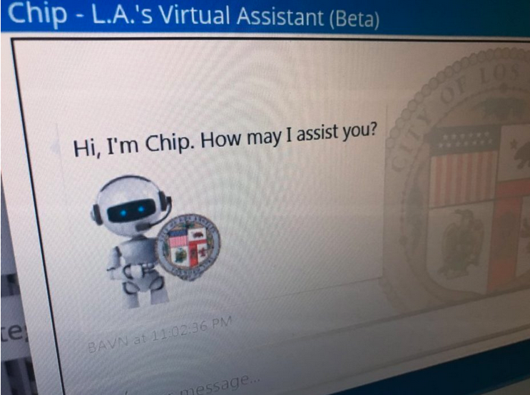
Government
Demo
Improving Customer Service via Virtual Agents
Intelligent Kiosk
Notes:
15 min – Chris to drive , Puneet to add Gov use cases
Chris – Intelligent Kiosk
How this will work in Gov –Puneet
Bots, Video Indexer, Vision, Speech
https://www.labavn.org/#
https://support.microsoft.com/en-us/contactus/
https://www.bing.com/images/search?view=detailV2&ccid=ToFk3GG7&id=1C6C633726C8601908707C65141169A3AF502471&thid=OIP.ToFk3GG7cFDzIZNWpk01HgHaEK&mediaurl=https%3a%2f%2fi.ytimg.com%2fvi%2fe18jB7qcnGA%2fmaxresdefault.jpg&exph=720&expw=1280&q=Military+Hum+V&simid=608020394427810547&selectedIndex=15&ajaxhist=0
https://www.bing.com/images/search?view=detailV2&ccid=7n4DSzzx&id=7E468EB08929FA6BC3068A8E0D6DFAEA3284C666&thid=OIP.7n4DSzzx5EENSH2ARyxHhgHaD4&mediaurl=https%3a%2f%2fwww.armytimes.com%2fresizer%2feyjE__lvtDvDkJVzeLR3ugRZfWw%3d%2f1200x0%2ffilters%3aquality(100)%2farc-anglerfish-arc2-prod-mco.s3.amazonaws.com%2fpublic%2fNALOTTTLVFCQLE2WTHS3LBKX6I.jpg&exph=629&expw=1200&q=Military+Hum+V&simid=608004850980096331&selectedIndex=3&ajaxhist=0
https://www.bing.com/images/search?view=detailV2&ccid=aAhXMxTy&id=B1F58C0E307BE6432B4BA0BD475A70B7E839B649&thid=OIP.aAhXMxTyV-WrNKzraL5sbwHaFn&mediaurl=https%3a%2f%2fweb.ipmsusa3.org%2fsites%2fdefault%2ffiles%2freviews%2fm103a2-heavy-tank%2fm103a2_three_quarters_right_front_view.jpg&exph=982&expw=1295&q=tank&simid=607988693300281537&selectedIndex=1&ajaxhist=0

Slide 7

Government
Demo
JFK FILES
Notes:
10 min - Chris to drive the demo , Puneet to add Gov related use-cases commentary –
How this will work in Gov –
https://jfkfiles2.azurewebsites.net/

Slide 8
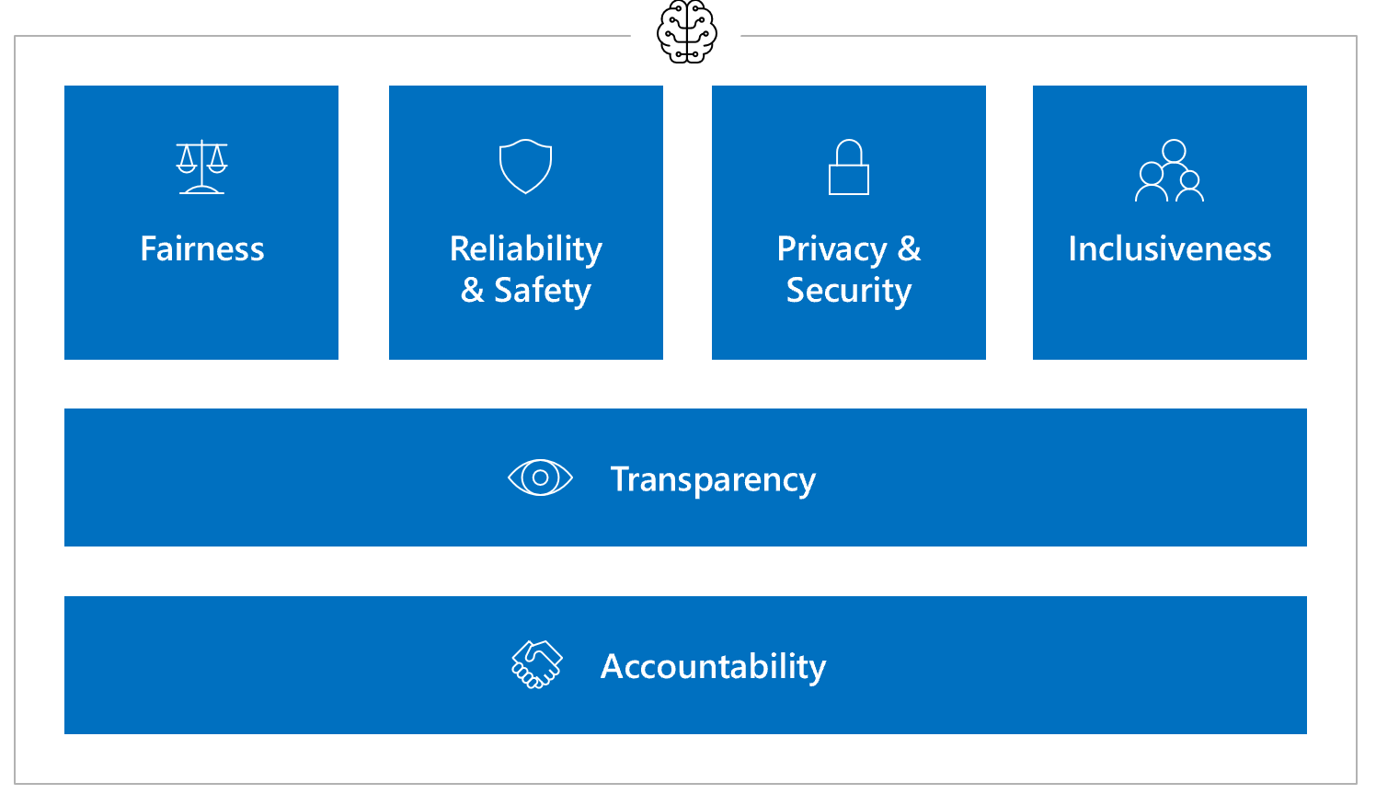
AI Trust and Ethical Considerations

